Slide 1
Simulation and Forecasting
Kumar Aryan
Mitesh Shah
Priyanka Joshi
Sandeep Musuluri

Slide 2
Introduction
Data Collection and Preprocessing
Visualization of Adjusted Close Prices
Time Series Analysis: ACF and PACF
Moving Averages
LSTM Model: Structure and Training
ARIMA Model: Structure and Training
Model Comparison and Results
Conclusion and Future Work

Slide 3
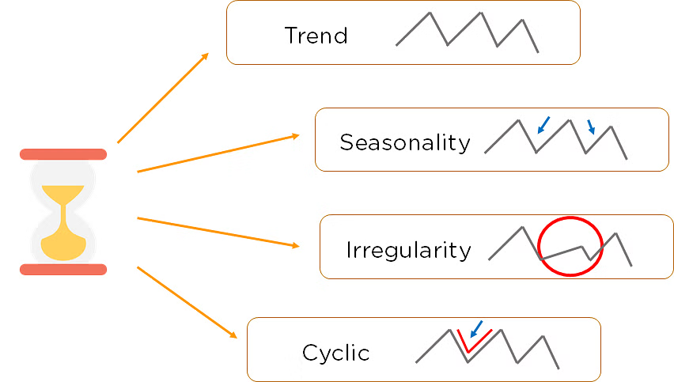
COMPONENTS OF TIME SERIES

Slide 4

Problem Definition
Data Quality and Quantity
Non-Stationarity
Seasonality and Trends
Model Selection and Complexity
External Factors
Irregular Data

Slide 5
Information Gathering
Data Acquisition
Yahoo Finance(GOOGLE)
Time Range of 10 years
Data Visualization
Matplotlib
Moving Average
Autocorrelation Analysis
ACF and PCF
Data Normalization
Scaler
Visualization of Prediction
Comparison: Actual vs Predicted price

Slide 6
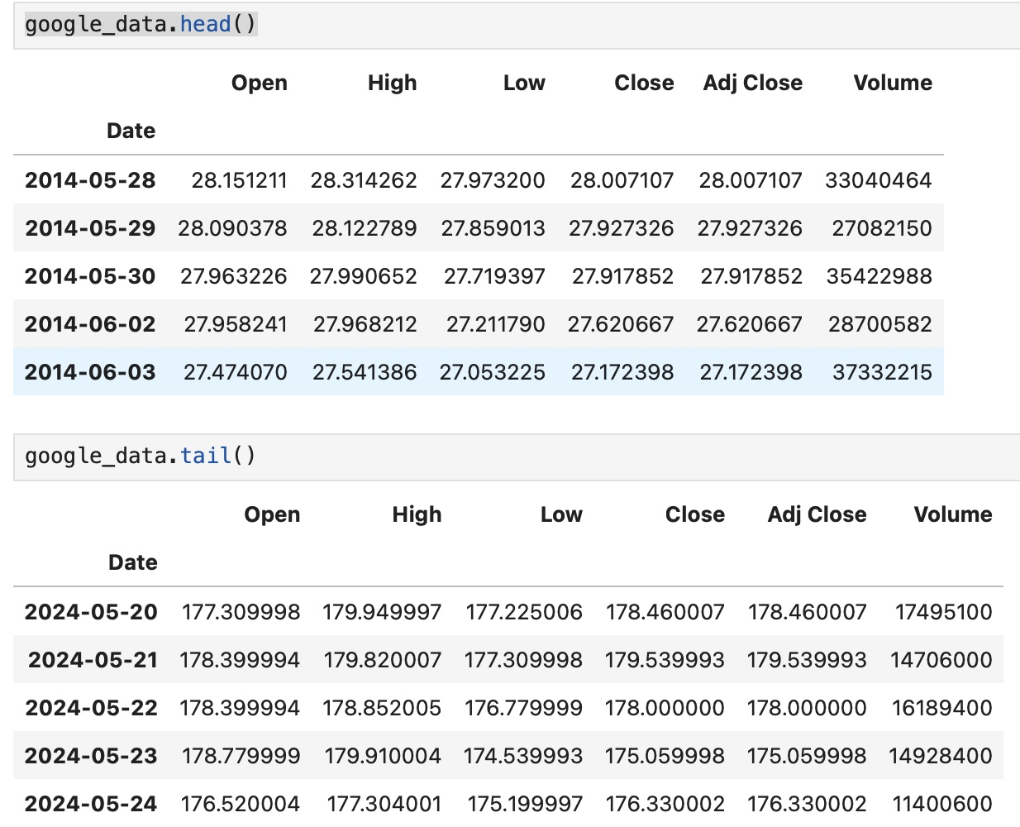
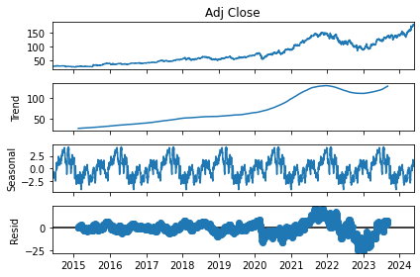
EXPLORATORY ANALYSIS

Slide 7
Model Selection
LSTM (LONG SHORT-TERM MEMORY)
Recurrent neural network.
Suited for processing sequential data.
Effectively captures long-term dependencies.
ARIMA
ARIMA stands for Auto-Regressive Integrated Moving Average.
It is a popular statistical method for time series forecasting.

Slide 8
LSTM
What is it?
LSTM (Long Short-Term Memory) is a type of recurrent neural network (RNN) used for processing sequential data, such as time series.
How it Works?
LSTMs are designed to remember information for long periods of time, allowing them to capture both short-term and long-term dependencies in the data.
Benefits
LSTM models can often outperform traditional time series techniques, especially for complex, non-linear data with long-term dependencies.
Applications
LSTM models are widely used in areas like financial forecasting, natural language processing, and speech recognition.
EQUATION:
\[
\begin{align*}
i_t & = \sigma(W_{xi}x_t + W_{hi}h_{t-1} + b_i) \\
f_t & = \sigma(W_{xf}x_t + W_{hf}h_{t-1} + b_f) \\
g_t & = \tanh(W_{xg}x_t + W_{hg}h_{t-1} + b_g) \\
o_t & = \sigma(W_{xo}x_t + W_{ho}h_{t-1} + b_o) \\
c_t & = f_t \cdot c_{t-1} + i_t \cdot g_t \\
h_t & = o_t \cdot \tanh(c_t)
\end{align*}
\]

Slide 9
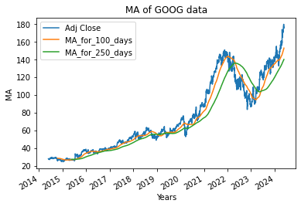
Moving Average
Moving Average 100 and 250 Days
Trend Identification
Signal Generation
Crossovers between different moving average periods can generate buy and sell signals, informing trading strategies and investment decisions.
Moving averages can help identify the underlying trend in a time series, distinguishing it from short-term fluctuations.
Volatility Smoothing
Calculating moving averages can effectively smooth out the volatility in a time series, making it easier to detect patterns and trends.

Slide 10
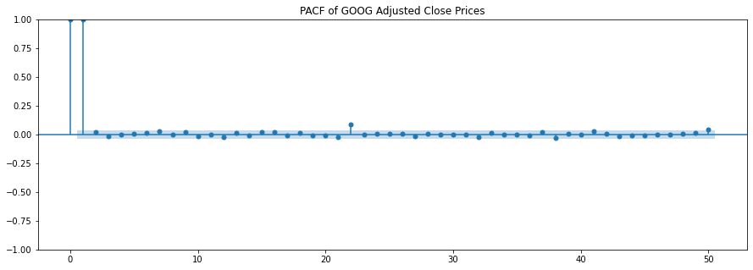
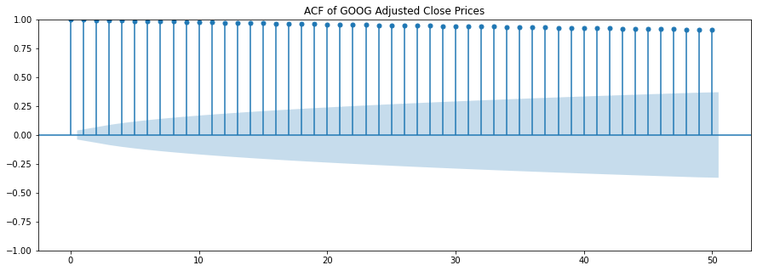
ACF & PACF
Identify Patterns
ACF and PACF can reveal the underlying structure and dependencies within a time series, guiding the selection of appropriate forecasting models.
Detect Seasonality
Periodic patterns in the ACF and PACF can indicate the presence of seasonality in the data, which should be accounted for in the forecasting model.
Determine Lags
The analysis of these functions can help determine the optimal lag structure for time series models, such as ARIMA or LSTM.

Slide 11
Model use and Back testing
ETFs: GOOGLE
LSTM : Model used for prediction.
Date Range: Last 10 years up to the current date.
Data Download: Using yfinance to get historical data for each ETF.
Moving Averages: Calculated for 100 days and 250 days.
Percentage Change: Calculated for adjusted close prices.
Normalization: Using MinMaxScaler to scale adjusted close prices.
Train-Test Split: 70% for training data and 30% for testing data.
RMSE calculation: RMSE is calculated for both models.
Result Visualization: A plot comparing LSTM & ARIMA with actual data.

Slide 12
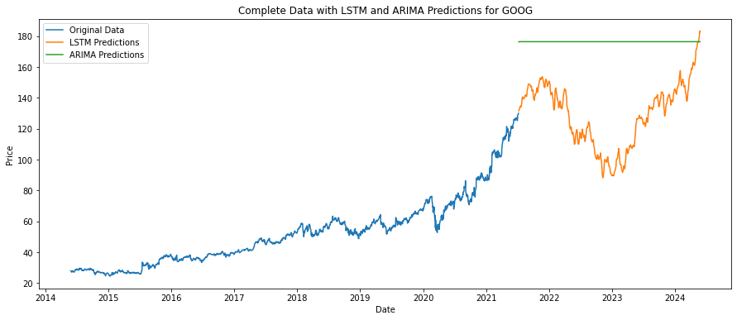
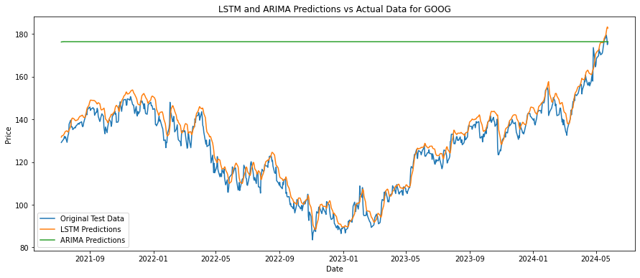
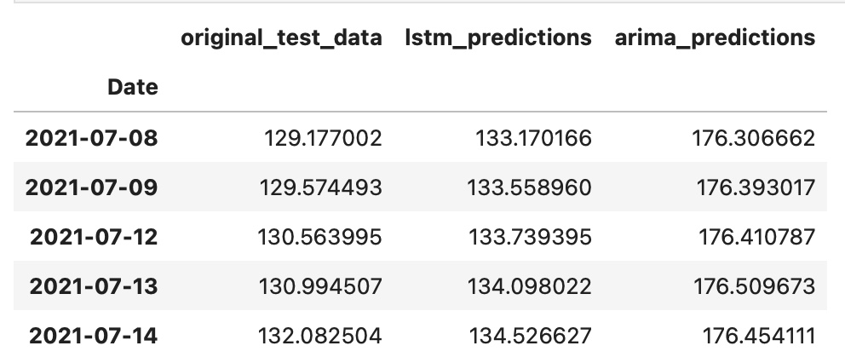
Fitting The Model
LSTM RMSE for GOOG: 4.440689452155599
LSTM Mean Error Rate for GOOG: 2.87%
ARIMA Mean Error Rate for GOOG: 43.35%
Based on these metrics, the LSTM model is clearly better than the ARIMA model. The LSTM model has a significantly lower Root Mean Square Error (RMSE) and Mean Error Rate compared to the ARIMA model.
Thus, the LSTM model provides more accurate predictions for the given dataset.

Slide 13

THANK YOU

